Slide 1












Mini Project
6 sem/3rd year (AIML)
Group no. 8
Project Guide: Prof. Yogesh Narekar

Slide 2




Our Team:-
Himanshu Shrivastav
Sagar Bokade
Vaishnavi
Dhekwar
Sanskruti Shastri

Slide 3
E- WASTE FACLITY LOCATOR

Slide 4
Problem Statement:- E-Waste Facility Locator
Website that tells you the location of the nearest e-waste collection and recycling facility. Offers educational pop- ups on the harmful components of your e-waste and their effects on the environment and human health if not disposed correctly. There could be an option to input the model of your old device and earn credit points relative to the amount of precious metals recovered from the device if disposed correctly.

Slide 5
FEATURES
Sign in
Log in
Log out
Nearby E Waste Facility
Credit Points
Our Helpline

Slide 6
OUTCOMES
Convenience: Users can easily locate the nearest e-waste collection and recycling facilities, making it convenient for them to dispose of their old devices responsibly.
Incentivized Recycling: The option to earn credit points for correctly disposing of old devices can incentivize users to recycle rather than discard their electronics.
Data Collection: You can collect data on the types and quantities of e-waste being recycled, which can be valuable for policymakers and researchers.
Community Engagement: The website can serve as a platform for community engagement and activism around environmental issues.

Slide 7
Corporate Responsibility: Encouraging manufacturers to take responsibility for the disposal of their products can lead to better recycling practices and product design.
Economic Opportunities: Recycling e-waste can create jobs and economic opportunities in the recycling and refurbishing industries.
Increased Awareness: By providing educational pop-ups about the harmful effects of e-waste, you can raise awareness among users about the importance of proper disposal.
Environmental Impact: Proper disposal of e-waste reduces the environmental impact of hazardous materials leaching into soil and waterways, and encourages recycling of valuable resources.

Slide 8
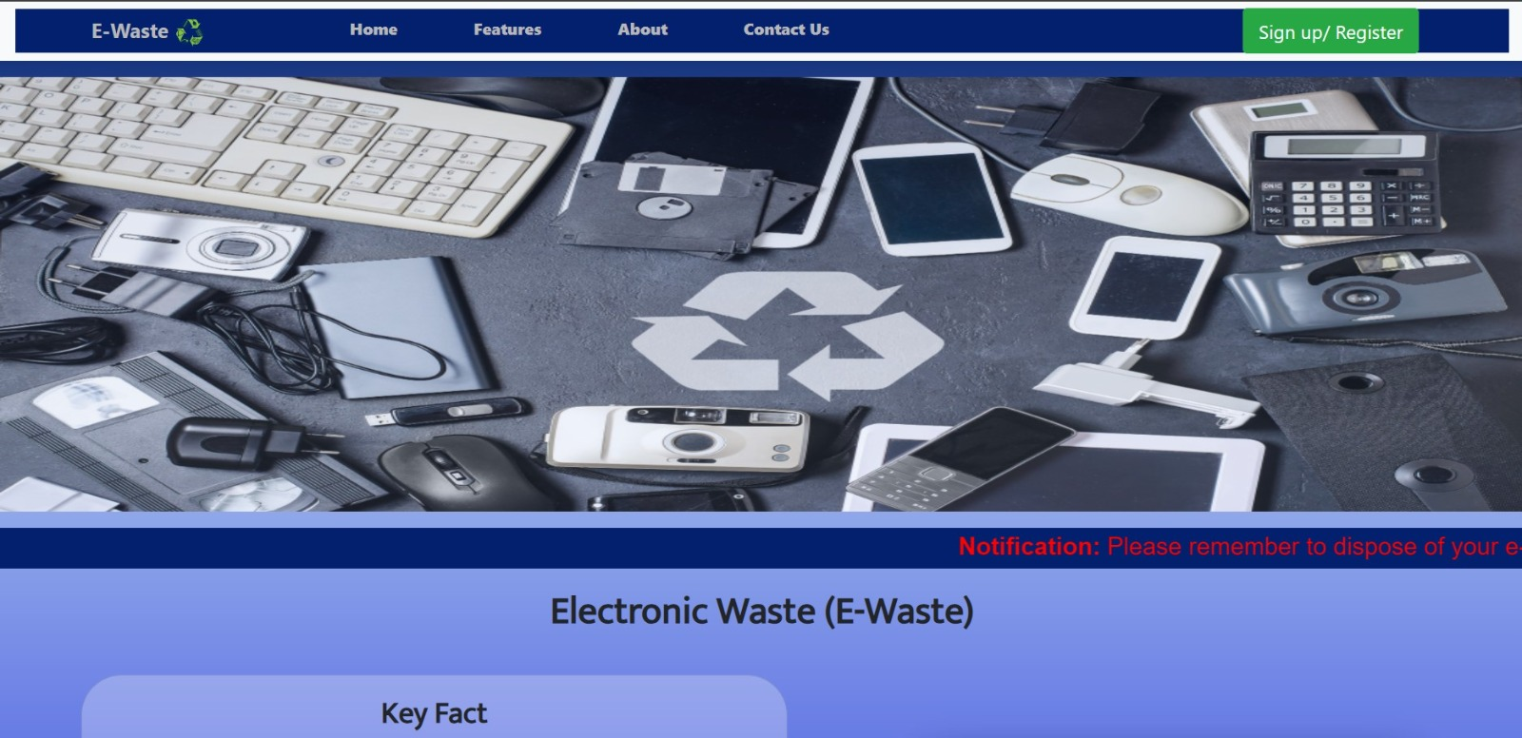
Overview of our webpage

Slide 9
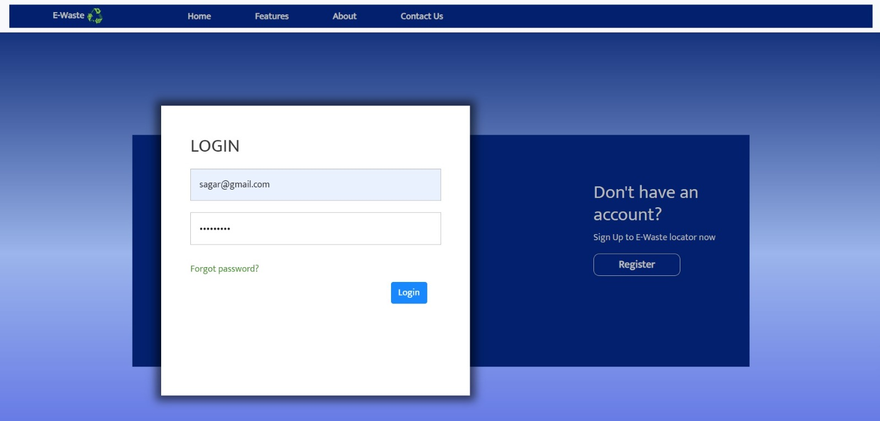

Slide 10
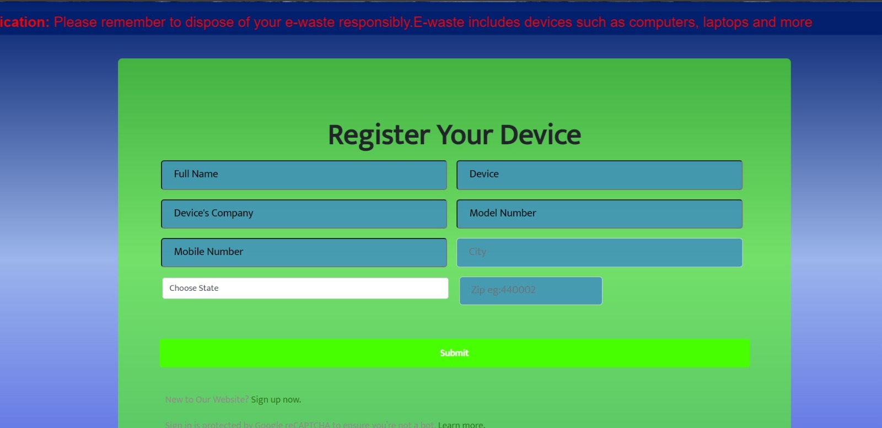

Slide 11
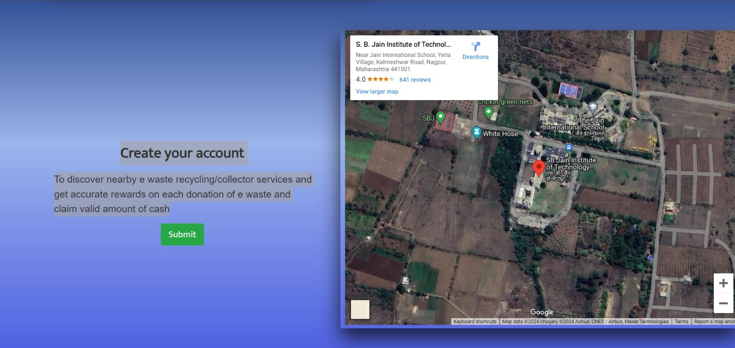

Slide 12
Thankyou

